Slide 1
Architecting for ML
On AWS
Amazon SageMaker
Emily Webber
Notes:
Yes you can ask a question if you have one. I will be stopping periodically to make sure you’re getting what you want and need.

Slide 2
Architecting for Machine Learning Agenda
Day 1
ML on AWS
NLP Lab
Teams
New Problem
Day 2
Feature Engineering
Project
Evaluation
Day 3
Going Into Production
Build
Present!
Write Up
New Model
Architecture

Slide 3
Feature Engineering
Deep Dive

Slide 4
Eighty percent of the data science work is feature engineering

Slide 5
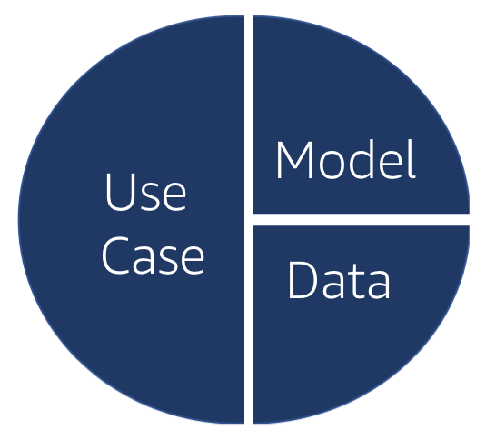
Feature Engineering
Conceptual, i.e. research-level
Practical, i.e. developer-level

Slide 6
Feature Engineering - Conceptual
What rows and columns are in my data set already?
Do those actually represent the real world?
How are they going to interact with my model?
Do I need to transform any columns? Normalize? Scale?
Do I need to remove any outliers?
Do I need to combine any columns?
Do I need to add additional features?

Slide 7
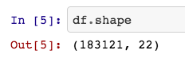
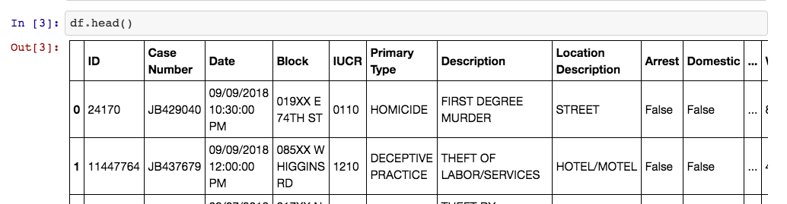
What rows and columns are in my data set?

Slide 8
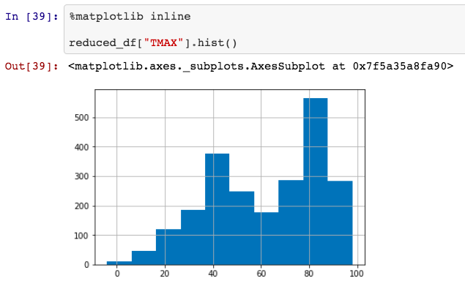
Do they represent the real world?

Slide 9
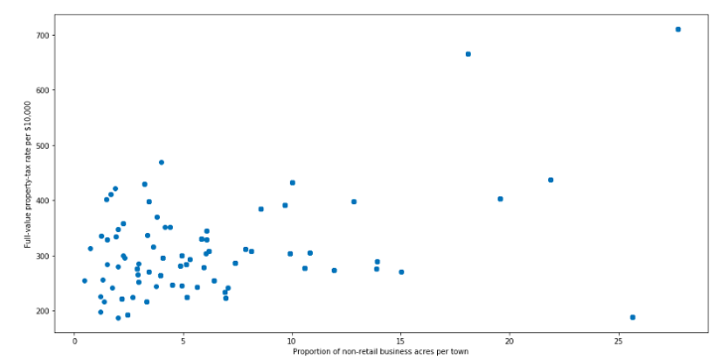
Do I need to remove any outliers?
https://towardsdatascience.com/ways-to-detect-and-remove-the-outliers-404d16608dba

Slide 10
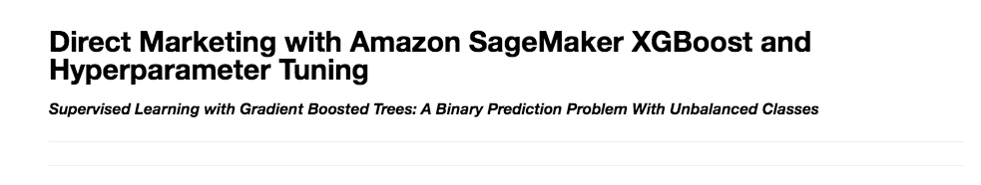
Do I need to combine any columns?
https://github.com/awslabs/amazon-sagemaker-examples/blob/master/hyperparameter_tuning/xgboost_direct_marketing/hpo_xgboost_direct_marketing_sagemaker_python_sdk.ipynb

Slide 11
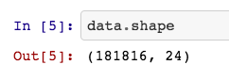
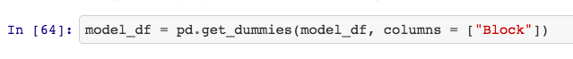
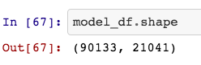
Do I need to transform any columns? One Hot Encoding
1
2
3

Slide 12
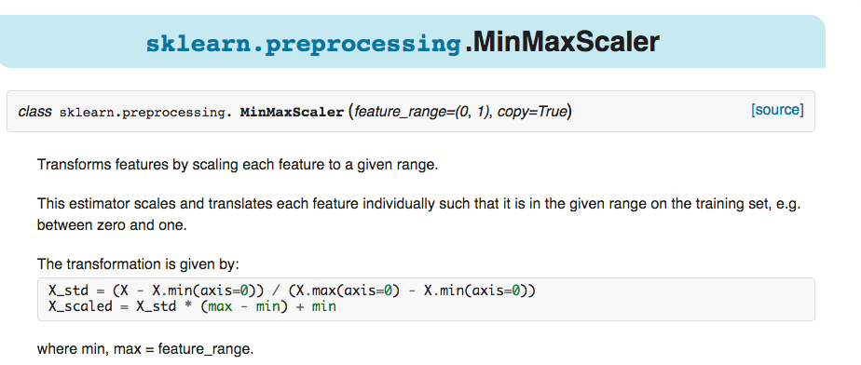
Do I need to transform any columns? Min Max Scaling

Slide 13
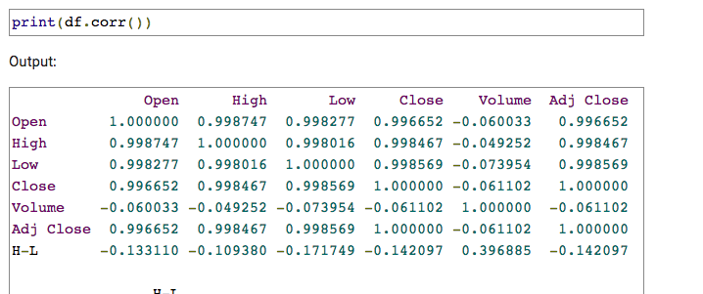
Are my x’s correlated with y? With other x’s?
Try to handle columns that are highly correlated with each other.
Try to not include columns that have very little correlation with the target.
https://pythonprogramming.net/pandas-statistics-correlation-tables-how-to/

Slide 14
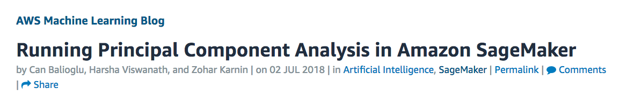
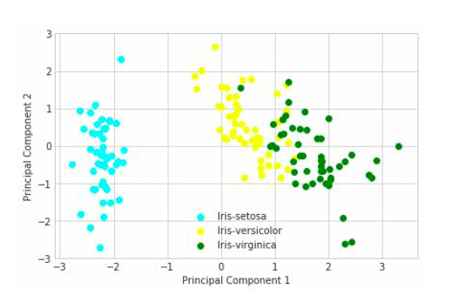
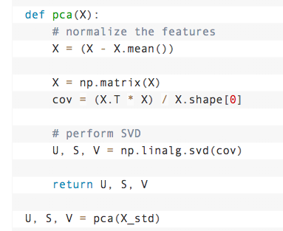
Should I find the basic components?

Slide 15
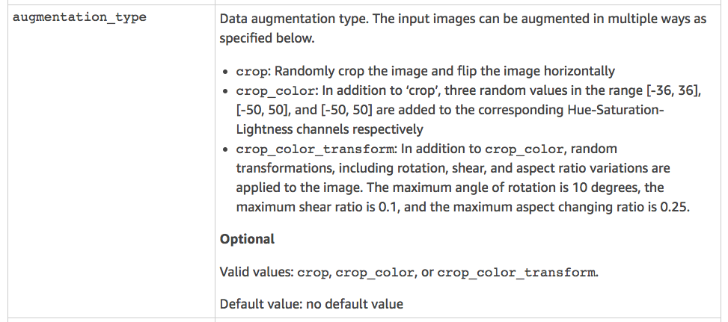


Should I use data augmentation?

Slide 16
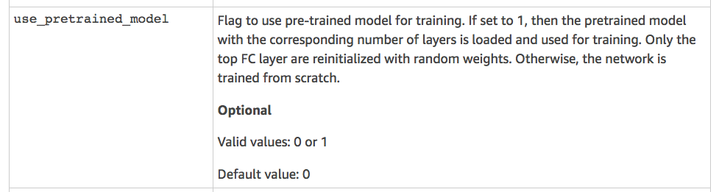


For Deep Learning: Should I use a pretrained model?
Hint:
YES!

Slide 17
Feature Engineering - Practical
How do I change the type of data I’m working with?
What Python and Pandas functions will I use?
Are my X’s and Y’s actually lining up? If not, why?
Do I have the mechanics properly set up?
Do I have everything I need to launch my training job?

Slide 18
Python & Pandas: DataFrame
import pandas as pd
df = pd.read_csv(“file_name.csv”)
headers = list(df)
df[“my columns”].hist()
for idx, row in df.iterrows():
d = row[“my column”]
df.iloc[idx, “other column”] = d

Slide 19
df positive_over_200 =df[ (df[‘target’] == 1) & df[‘value] > 200)] positive_over_200[‘value’].value_counts() df[‘new_column’] = [“s” for i in range(df.shape[0])] merge, concat, join !aws s3 cp s3://source_bucket/file_name.csv . !aws s3 sync s3://source_bucket/folder . !aws s3 sync source_folder s3://source_bucket/folder pd.get_dummies(df, columns)

Slide 20
Course Materials Download https://tinyurl.com/y4d7nfay

Slide 21
Model Comparison
Deep Dive

Slide 22


Confusion Matrix
Your Model’s Predictions
Positive
Negative
Recall
True
Positive
False
Negative
Your Labeled Data
Positive
Negative
False
Positive
True
Negative
Precision

Slide 23

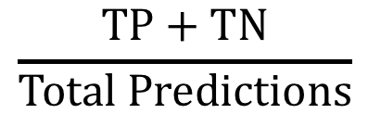

Common Model Evaluation Metrics
$$\frac{TP+TN}{Total Predictions}$$
$$\frac{TP}{Positive Predictions}$$
$$\frac{TP}{Positive Samples}$$
Accuracy
Precision
Recall
AUC of ROC

Slide 24
Receiver Operator Curve
True Positive Rate
False Positive Rate

Slide 25
Hyperparameter Tuning
The model features
Additional terms to tweak
Extra math
Try as much as you can

Slide 26
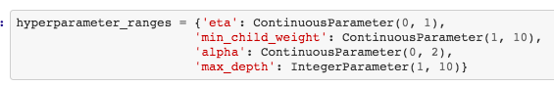
SageMaker Hyperparameter Tuner
1. Pick hyperparameters and ranges

Slide 27
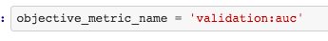
SageMaker Hyperparameter Tuner
2. Pick objective metric

Slide 28
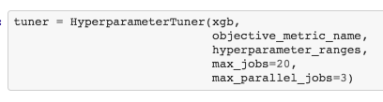
SageMaker Hyperparameter Tuner
3. Pick job parameters

Slide 29
78%
AUC
50%
Time

Slide 30
Other key evaluation metrics
Regression
Linear Learner *
XGBoost
KNN
RMSE – root mean squared error
MAPE – mean average percentage error
Clustering
ssd – mean squared distance
msd – sum squared distances
Kmeans *

Slide 31
It is very helpful to align model evaluation directly with business goals.

Slide 32
Loss Function – Give different impact to different errors when training the model
Training
Economic Weights– Quantify the economic impact of the model outputs to evaluate results
Analysis

Slide 33
https://aws.amazon.com/blogs/machine-learning/training-models-with-unequal-economic-error-costs-using-amazon-sagemaker/

Slide 34
Use the evaluation questions to ask interesting questions about about your project. Over time, as you become a machine learning practitioner, you should be able to answer them. Today, don’t stress yourself out.

